Slide 1
Introduction to Meteor js

Slide 2
What is Meteor?
Meteor is an open source platform for creating rich web applications entirely in JavaScript.
Meteor is a full-stack JavaScript platform for developing modern web and mobile applications.
Meteor includes a key set of technologies for building connected-client reactive applications, a build tool, and a curated set of packages from the Node.js and general JavaScript community.

Slide 3
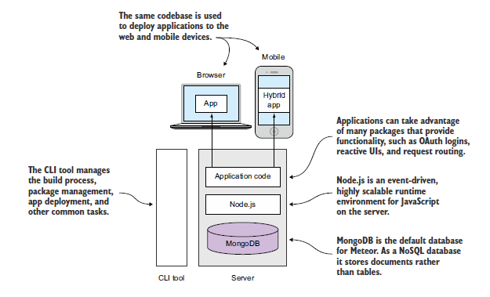
Architecture

Slide 4
Architecture
Meteor is an open source platform for creating rich web applications entirely in JavaScript.
It consists of Node.js, MongoDB, the actual application code, and a powerful CLI(Command Line Interface) tool that combines the power of npm and make.
It’s powered by Node.js on the server side.

Slide 5
Node.js is an event-driven, highly scalable runtime for JavaScript on the server. It serves the same purpose as an Apache web server.
All data is typically stored inside a MongoDB, a document-oriented NoSQL database.
It provides a JavaScript API that gives access to all stored content in the form of documents or objects.

Slide 6
The same language used inside the browser can be used to access data, which Meteor takes advantage of to implement true full-stack development.
All software and libraries required to create web applications from scratch are bundled in the shape of smart packages, so developers can get started right away.
These packages include a reactive UI library (Blaze), user account management (accounts), and a library for transparent reactive programming (Tracker).

Slide 7
CLI(Command line Interface)
The Meteor CLI tool allows developers to quickly set up an entire development environment.
There’s no need to know how to install or configure any server software.
It’s also both a build tool, comparable to make or grunt, and a package manager, such as apt or npm.
The CLI tool bundles an application to run on different client platforms, inside a web browser or as native mobile apps.

Slide 8
Features
Meteor allows to develop in one language, JavaScript, in all environments: application server, web browser, and mobile device.(isomorphic)
Meteor uses data on the wire, meaning the server sends data, not HTML, and the client renders it.
Meteor embraces the ecosystem, bringing the best parts of the extremely active JavaScript community to in a careful and considered way.
Meteor provides full stack reactivity, allowing UI to seamlessly reflect the true state of the world with minimal development effort.

Slide 9
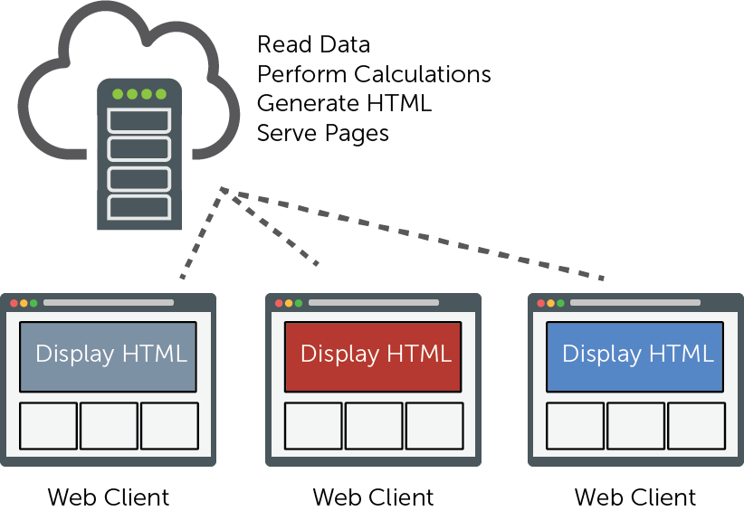
client/server

Slide 10
client/server
A server with significantly more processing power than a client will perform operations on data (writing records to a database, math calculations, text searches, and so on), transform the data and render it (turn adatabase record into HTML and so on), and then serve the result to the client.
The client acts as more of a display, or a dumb terminal

Slide 11
MVC
The server code (controller) performs business logic against the database(model) through the use of business objects and then sends processed/rendered data to the client application (a "view").

Slide 12
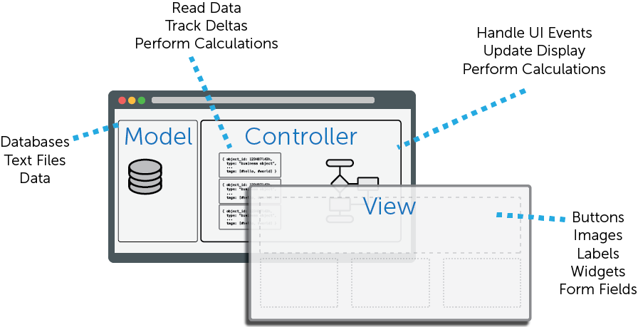
MVC

Slide 13
Nested MVC
The server code (controller) performs business logic against the database(model) through the use of business objects and then sends processed data to the client application (a "view").
The client receives this data from the server and treats it as its own personal ‘model’. The client would then act as a proper controller, perform logic, and send the information to the view to be displayed on the screen.

Slide 14
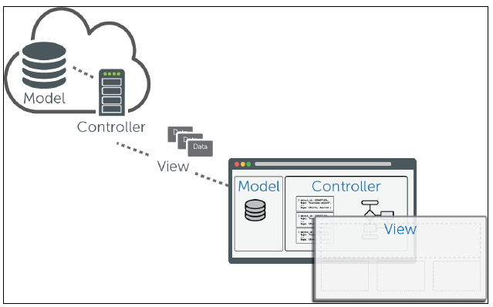

Slide 15
Data on the Wire
Instead of having a server process everything, render content, and then send HTML across the wire, why not just send the data across the wire and let the client decide what to do with it?
This concept is implemented in Meteor using the Distributed Data Protocol, or DDP.

Slide 16
DDP(Distributed Data Protocol)
When using a back end running a Java, PHP, or Rails application, processing takes place far away from the user. Clients request data by calling a URI. In response, the application fetches data from a database, performs some processing to create HTML, and sends the results to a client.
When the processing power of clients was relatively limited this made perfect sense, but these days a single iPhone already has more computing power than most supercomputers in the early days of the web.
Meteor takes advantage of that power and delegates most of the processing to the clients.
Smart front ends request data from the server and assemble the Document Object Model (DOM) only in the browser or mobile device

Slide 17
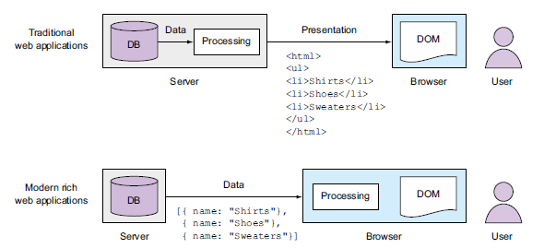
DDP

Slide 18
Moving the processing from a single server to multiple clients involves moving into the direction of distributed computing platforms. In such distributed environments, data needs to be sent in both directions.
In Meteor, the browser is a smart client.
The server may send data to the client whenever there are updates to subscribed content.

Slide 19
To allow bidirectional communication between server and client, Meteor uses Web Sockets.
A standardized protocol named Distributed Data Protocol (DDP) is used to exchange messages.
DDP is a standard way to pass data over WebSockets bidirectionally, without the overhead of encapsulating documents.
DDP is simple to use and can be used with many other programming languages like PHP or Java as well.

Slide 20
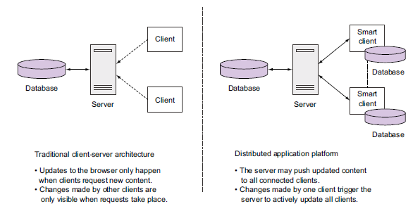

Slide 21
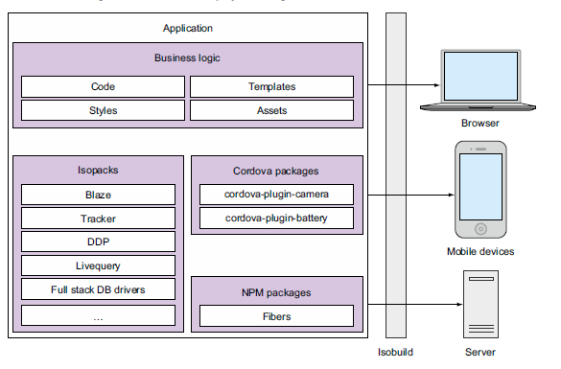
Working of Meteor

Slide 22
Developers define business logic that consists of code, templates and styles, and assets such as image files.
Meteor can leverage the power of external packages from the Node.js ecosystem via npm and Cordova for mobile devices.
Additionally, it defines its own package format called Isopacks.

Slide 23
Isopacks are designed to work in both server and client environments and may also contain templates and images.
They may even extend Isobuild, the build process that outputs deployable code for all targeted platforms.
Meteor applications communicate over both HTTP and WebSockets.

Slide 24
The initial page request and all static files such as images, fonts, styles, and JavaScript files are transferred over HTTP.
The applications running on client and server rely on the DDP protocol to exchange data.
The client calls methods on the server using remote procedure calls. The client is calling a function over the network.
The server sends back its responses as JavaScript Object Notation (JSON) objects.

Slide 25
The Livequery component takes care of pushing out any changes to a subscribed dataset over DDP as well.
The reactive Tracker library watches for those changes and triggers DOM updates in the UI layer via Blaze.

Slide 26
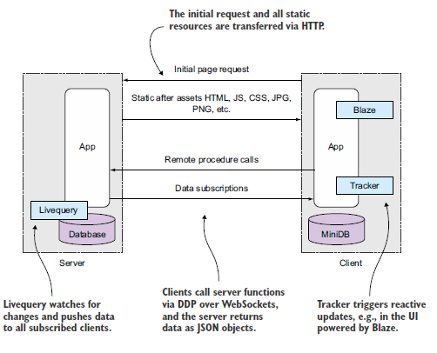

Slide 27
BLAZE
Blaze is a reactive UI library, and one of its parts is the templating language Spacebars.
Because developers usually (only) interact with the front-end lib via the templating language and Spacebars is relatively easy to use (in comparison to other templating languages),
The official documentation describes Blaze as a “reactive jQuery,” a powerful library to update the DOM. But it doesn’t follow the same imperative style jQuery uses (“find element #user-list and add a new list node!”), but a declarative approach (“render all usernames from the DB in this list using templates users!”).
When content changes, Blaze re-renders only small fragments inside a template and not the entire page. It also plays nicely with other UI libraries such as jQuery-UI.

Slide 28
Tracker
The Tracker package provides the fundamentals of functional reactive programming (FRP).
At its core Tracker is a simple convention that allows reactive data sources, such as data from the database, to be connected to data consumers.

Slide 29
Eg: c= a+b;
a and b are reactive data sources, and c is the consumer. A change to either a or b triggers a recomputation of c.
Tracker achieves reactivity by setting up a reactive context with dependencies between data and functions, invalidating the given context whenever data changes and reexecuting functions.

